Slide 1
Fast-Tag Fraud Detection

Slide 2
Contents
Introduction
Problem Statement
What is Fast-Tag
Exploratory Data Analysis
Feature Engineering
Model Development

Slide 3

The project aims to develop a robust and reliable fraud detection system for FastTag transactions. By employing advanced machine learning algorithms and data analytics, we strive to identify and mitigate fraudulent activities in real-time, ensuring the integrity of the toll collection process and enhancing the trust of users in the FastTag system.
Introduction

Slide 4

Problem Statement
This internship project focuses on leveraging machine learning classification techniques to develop an effective fraud detection system for Fast-Tag transactions. The dataset comprises key features such as transaction details, vehicle information, geographical location, and transaction amounts. The goal is to create a robust model that can accurately identify instances of fraudulent activity, ensuring the integrity and security of Fastag transactions.

Slide 5

What is Fast-Tag
FastTag is an innovative electronic toll collection system in India that leverages Radio Frequency Identification (RFID) technology to automate toll payments. While FastTag significantly enhances the convenience and efficiency of toll collection, it is also susceptible to various fraudulent activities, which can lead to revenue losses and compromised security.

Slide 6
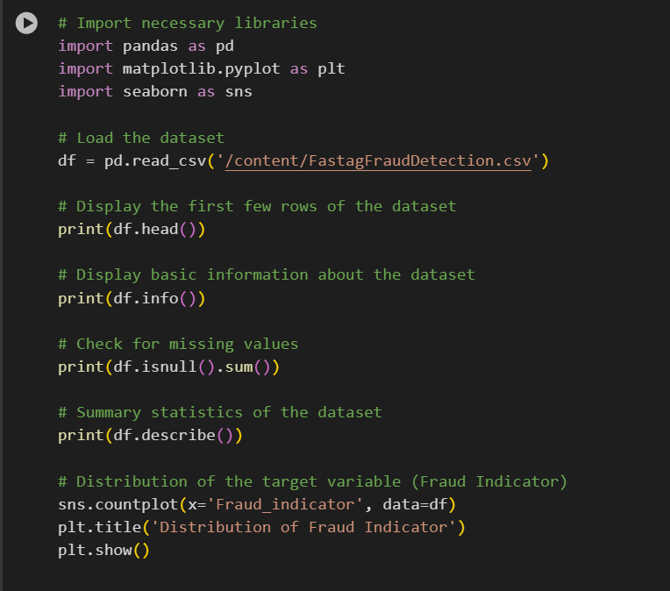
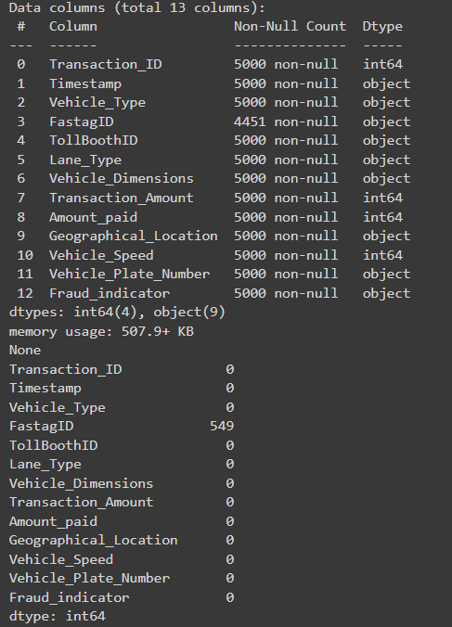
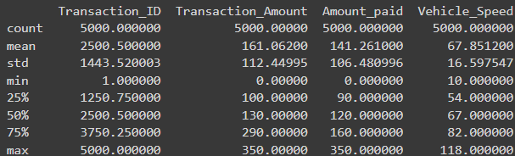
Exploratory Data Analysis(EDA)
Loading the dataset
Viewing the basic info
Finding missing values in each column
Summary of the Dataset

Slide 7
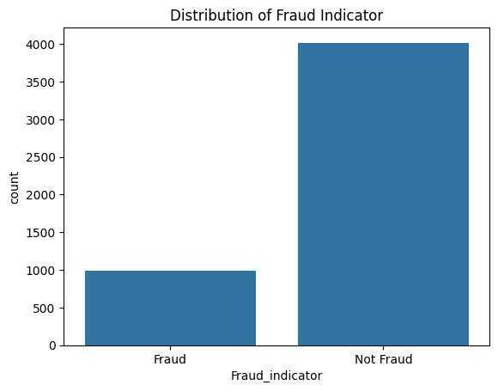
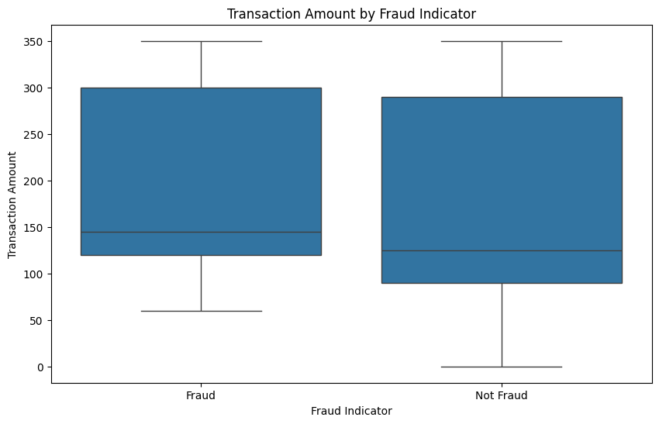
The first graph shows the distribution of transactions that are Fraud and those which are not Fraud.
Second graph displays the box-plot which represents the Range ,Mean of the Fraud and Not Fraud Transaction amount.

Slide 8
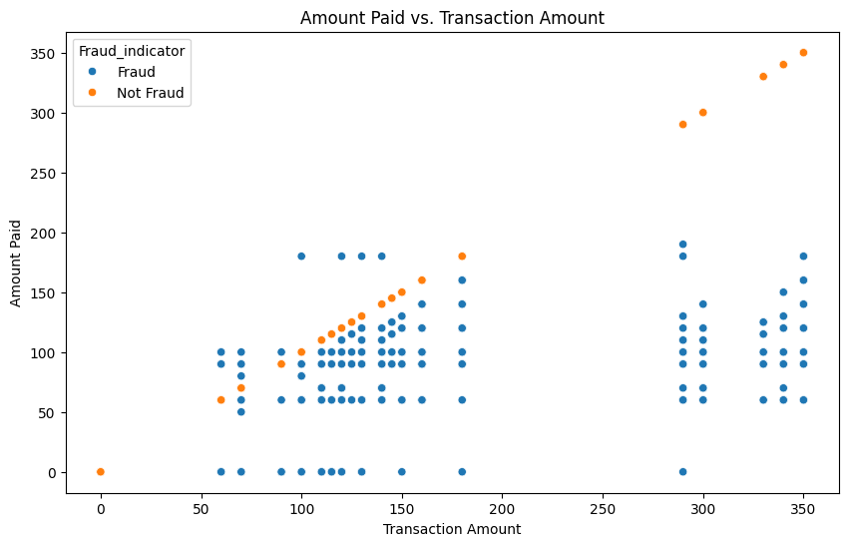
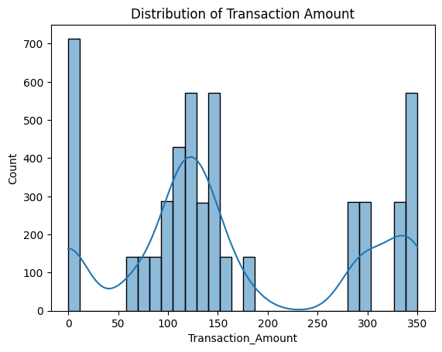
The graph displays the co-relation amount paid and transaction amount , while the not fraud plots a straight line across the graph.
The next graph displays the distribution of the Transaction amount from the data set

Slide 9
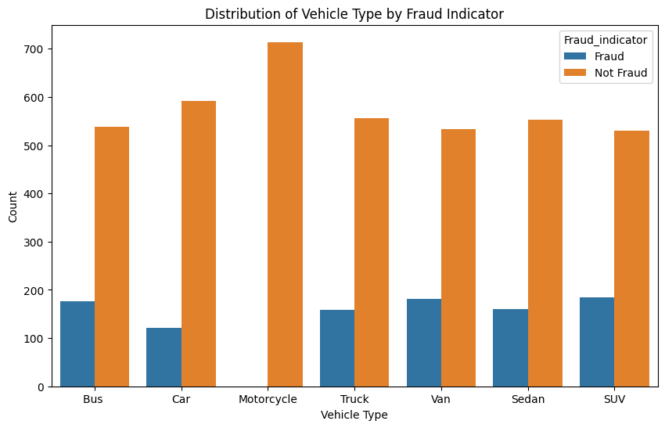
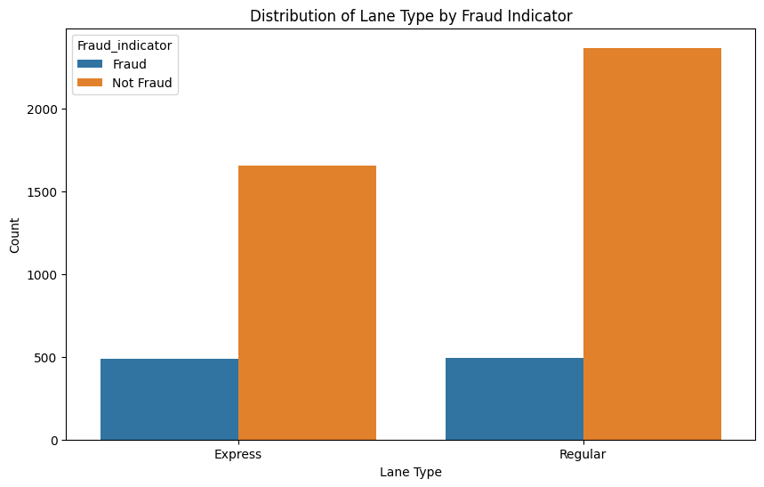
The graph represents the Vehicle type separated by the Fraud and Not Fraud Transactions
This graph shows the Fraud and Not Fraud Transactions distributed by the type of lanes.

Slide 10
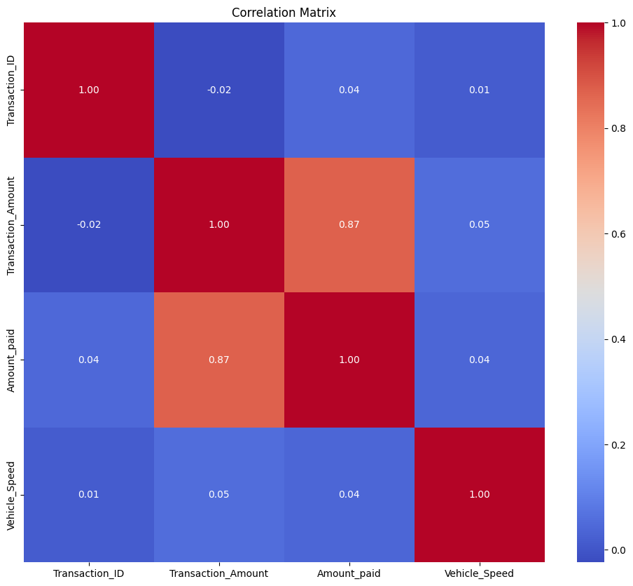
Graph represents the correlation with the target variable

Slide 11
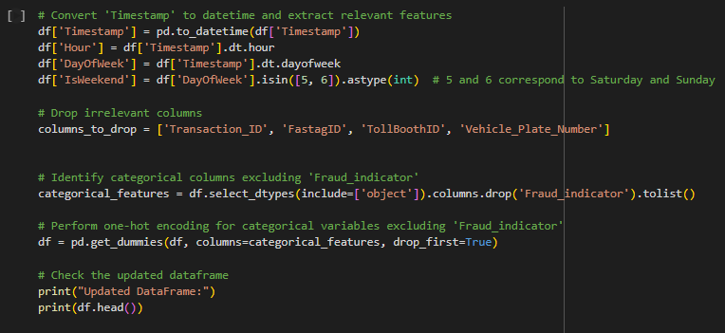
Feature Engineering

Slide 12
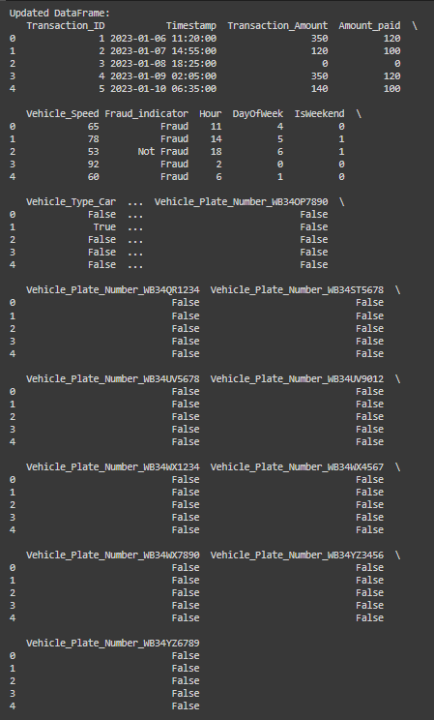
Once the Feature Engineering Process is completed , we can view the updated Dataframe which looks something like this

Slide 13
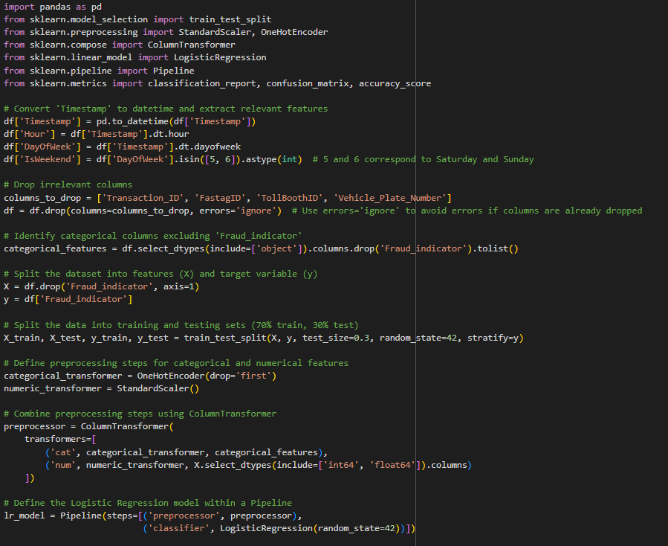
Model Development
For the model development process , we have chosen Logistic Regression
Here you can see the steps which include dropping irrelevant columns , splitting the dataset .

Slide 14
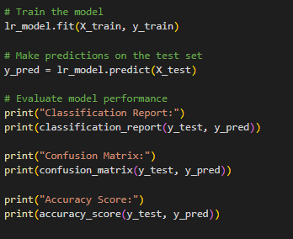
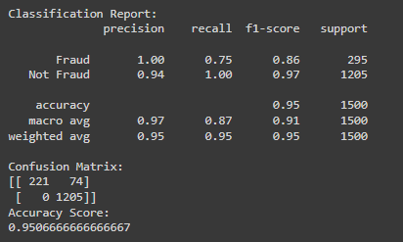

Once we fit the model , we run these commands to find out the accuracy of the model that is built.
The accuracy derived of Logistic Regression is around 95%.
After hypertuning the model , the accuracy is increased to 97%.

Slide 15
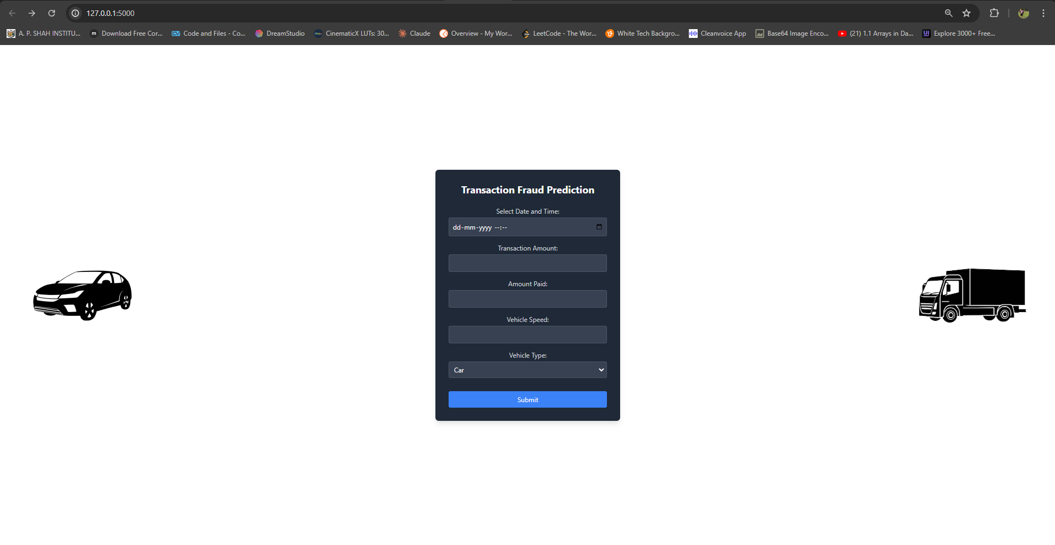
Fast-Tag Fraud Detection

Slide 16
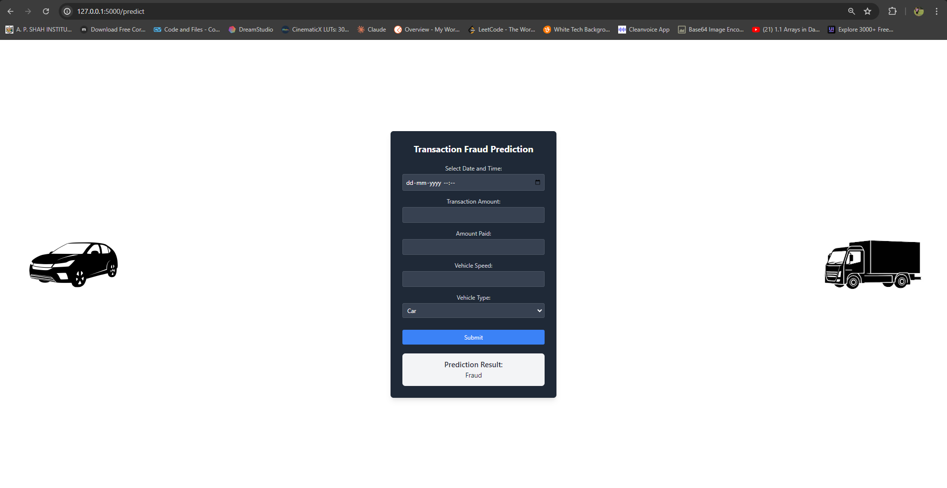

Slide 17
Thank you
Vedant Mayekar
vedantmayekar647@apsit.edu.in

